Slide 1
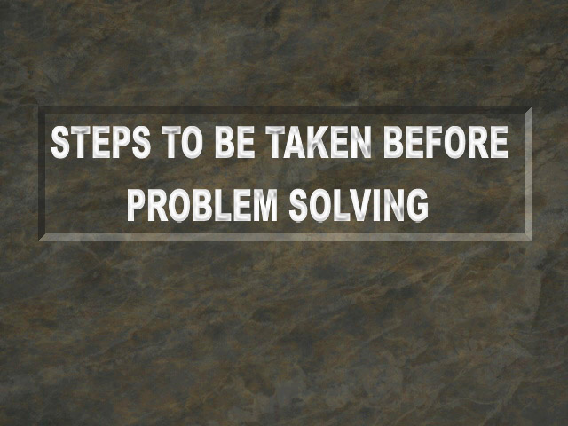

Slide 2
Deming Wheel
Before learning about problem solving technique we should first concentrate upon how to prevent problems.
Problems can be controlled or minimised by effective use of P-D-C-A cycle or Deming’s Wheel.

Slide 3
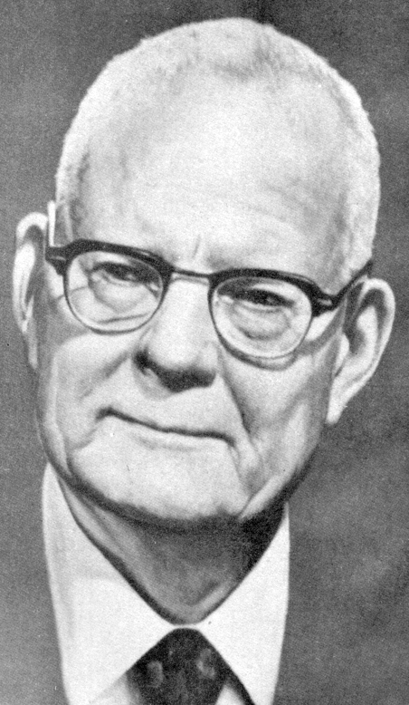
Dr Deming suggested a four step formula for effective functioning of any section/organisation with proper quality control system.

Slide 4

This was accredited to him by the Japanese as ‘Deming Wheel’, but Dr Deming himself however said that, it was Dr Shewhart’s idea and that the diagram should be called as the Shewhart cycle.

Slide 5
The PDCA cycle is as follows:
ACT
PLAN
CHECK
DO

Slide 6
Dr K Ishikawa made these four steps into six steps as follows:
DECIDE ON THE OBJECTIVE AND TARGETS
ACT
PLAN
TAKE ACTION
DECIDE METHODS OF ACHIEVING THE OBJECTIVE
CARRY OUT EDUCATION AND TRAINING
CHECK THE RESULT
CHECK
DO THE WORK
DO

Slide 7
When these six steps have been followed, a seventh step is needed to ensure whether the corrective action has been worked out or not. Let us see these six steps in detail.

Slide 8

PLAN (1)
1. Decide on objectives and targets

Slide 9

PLAN (1)
Control is impossible if we do not have clearly defined objectives and targets which are stable.

Slide 10

PLAN (1)
a) Objectives are decided as a result of policy and they must be broken down into sub-policies, clearly spelling out what are the responsibilities and authority in each level.

Slide 11
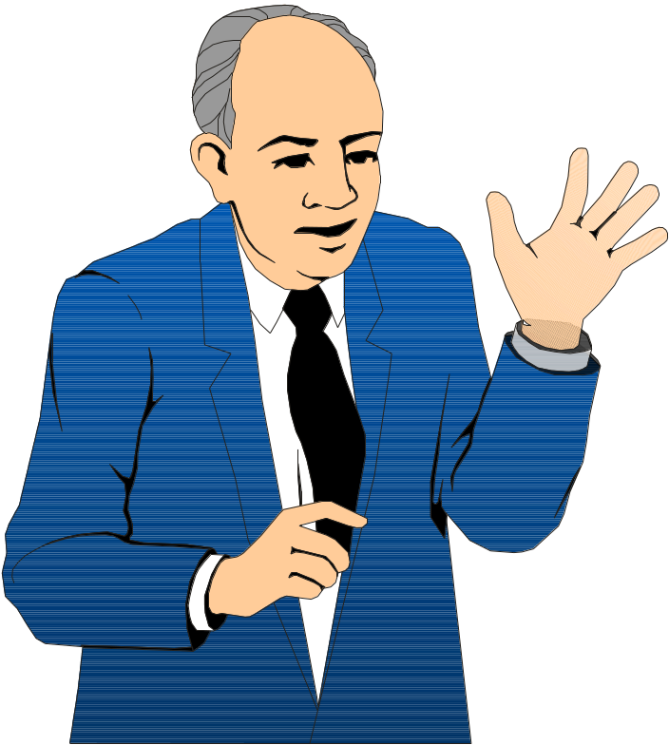
PLAN (1)
Our policies are
rationale and
clear cut for
all levels.
b) Policies must have a proper rationale.

Slide 12

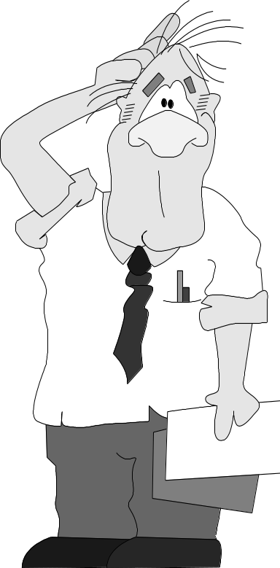
PLAN (1)
Don’t issue policies in fragmental. Don’t you know ours is an ISO 9000 company?
c) Policies must be decided from an overall point of view and not to be issued in fragments.

Slide 13
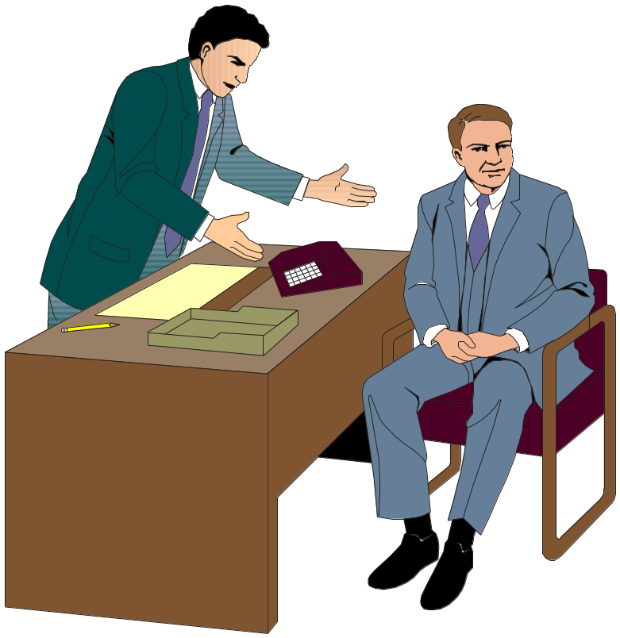
PLAN (1)
While setting policies give our priorities to customers’ complaint.
d) While setting policies we must decide on our priorities.

Slide 14
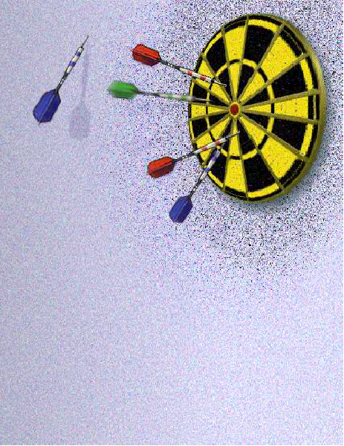
PLAN (1)
e) Objectives or targets should be stated clearly and specifically and, if possible, with concrete deadlines (time frame) and in measurable terms.
Do we have concrete deadlines for our objectives?

Slide 15
PLAN (1)
f) Policies must be divided into two steps viz.,
i) Methodology : Ways and means
policy of achieving
objectives. (How)
ii) Objective : Specific objectives.
policy (What)

Slide 16

PLAN (2)
    2. Decide on the means of achieving objectives: standardization technology and administrative techniques.

Slide 17
PLAN (2)
Once the objectives are decided the next step is deciding on the means of achieving these objectives.
The technical and administrative staff should formulate a programme structure and continuously educate the staff. In process control we first do design analysis, formulate standards and revise those standards as we improve upon them.

Slide 18

PLAN (2)
You are acting
upon symptoms.
Find out the
root cause and deal
with that.
a) Standards, particularly technical and operating should deal with causes.

Slide 19
PLAN (2)
b) How to control the key factors for control of process must be decided. To identify these key factors, we must have a proper technical knowledge concerning the process.

Slide 20
PLAN (2)
c) Standardisation is carried out in order to delegate authorities. While authority should be delegated, not all the responsibilities could be delegated. It should be made clear as to what is to be done in exceptional or abnormal situations i.e.
• Who should do what (responsibility)
• How far they can go (authority)
• From whom they should receive instructions (Specialists or Superiors).

Slide 21

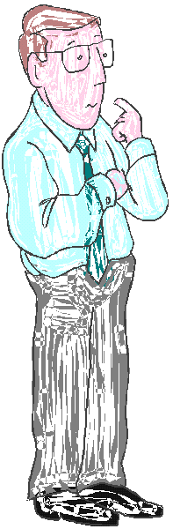

PLAN (2)
Why is he banging again the wall? He just read the standards prepared by me
d) Standards should be formulated to state the objectives clearly.

Slide 22

PLAN (2)
e) All the people who are involved should have a say in the standardisation.

Slide 23

PLAN (2)
f) "To err is human". Hence, instead of criticising one for the errors, we should look into prevention of such errors. It is not 'who did it' but 'why it occurred'.
I am not interested in knowing who did the mistake. Find out why it happened and introduce Poka Yoke

Slide 24

PLAN (2)
This standard is not revised for last eleven years! I am sure it is
not in use.
g) A standard that has not been revised is a standard that is not being used could be an obvious conclusion.

Slide 25
PLAN (2)
I have asked for standards. Don’t give me bits of papers.
h) Standards must be properly documented.

Slide 26

PLAN (2)
RULES FOR THIS OFFICE
1. You have power to decide on all issues.
2. But you should take my permission first.
3. Boss is never wrong.
4. If Boss is wrong please refer to rule no. 3.
i) All standards must be mutually consistent.

Slide 27
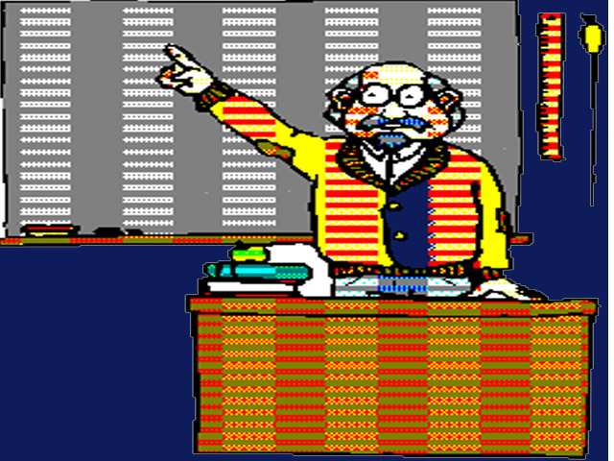
DO (1)
3. Carry out Education and Training

Slide 28
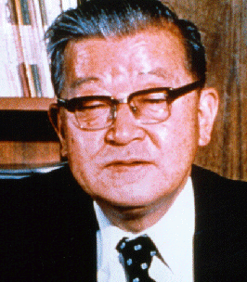
DO (1)
“When one teaches his people, it is not only transmitting knowledge and values but also reinforcing them within the teacher and enhancing one’s commitment to the values.”
All those in charge of people are responsible for training them also.

Slide 29
DO (1)
“A, B and C classification of problems is for Quality Circle Members to learn in a structured way.”
Training and education within a company consists of the following three actions.
i) Training in a structured way.

Slide 30
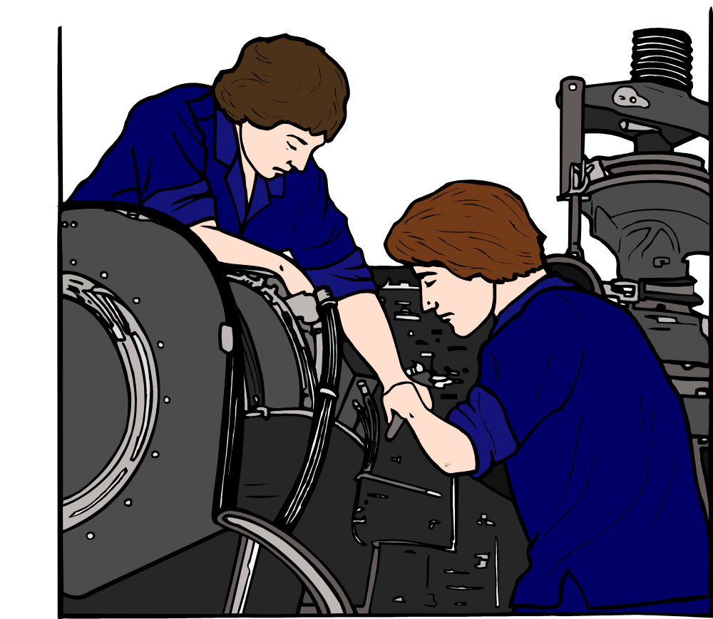
DO (1)
ii) On the job training of subordinates by superiors.

Slide 31


DO (1)
Sanjay you don’t bother about
mistakes. I am there to support
you. You make mistakes only
when you do work. There is no
other way to learn.
iii) Letting people learn for themselves boldly by giving them full authority for their work i.e., empowerment.

Slide 32

DO (2)
4. Do the work - Execute as per the plan of action.

Slide 33
CHECK
5. Check the results
Checking the results consists of seeing whether the work is being carried out in line with policies, instructions and objectives. All those in positions of authority must think carefully about where, when, what and how to check.

Slide 34
CHECK
When controlling a work, it should be checked by the following two methods.

Slide 35
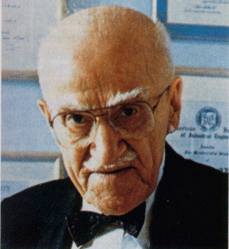
CHECK
“Walk the talk”
a) Check the causes. Take a walk around the work place and see whether everything is being carried out according to policies and standards. Although industrial processes are affected by an infinite number of causes, the following generalities apply:

Slide 36
CHECK
100
80
60
40
20
0
800
700
600
500
No of complaints
%
400
300
200
100
0
i) Only small number of causes can be pinned down as to not operating to standards and even these cannot be controlled 100% correctly.

Slide 37
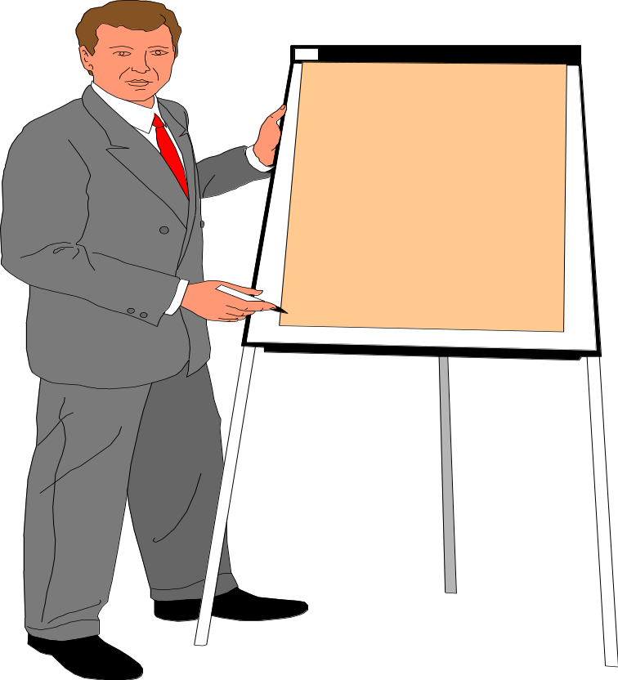
CHECK
Sample
We can not do hundred
percent check with limited
time available. Sampling
under SQC becomes
important
  ii) Because we have only a limited time, we can only see a small part of the work.

Slide 38
CHECK
b) Checking through results. This consists of checking whether work and processes are proceeding well by examining the results of the work.

Slide 39
CHECK
i) This concept is to be understood properly. Taking action with respect to the goods or product based on result is an inspection approach. This is an action with respect to the produced product and not to check the system. What we have to do is, based on the result, carry-out an action with respect to the work process, business and operations in control.

Slide 40
CHECK
ii) We must constantly make sure as to what is the most significant characteristic of the result of our work through which we can check the work. In other words, what are the critical points of the result that needs to be checked. That is, establishing quality check points.

Slide 41
CHECK
DEFECT LEVEL
LEVEL OF RESIN
  iii) Results are always scattered. The number of factors affecting the results of our work are limitless and we cannot control all of them.

Slide 42

CHECK
Sir, look into the distribution in this Histogram. Definitely there is shift in the process.
When an abnormality occurs we must examine how the distribution has changed. In other words we must make judgements and exercise control on statistical basis, using statistical tools.

Slide 43
CHECK
iv) In order to control a process by checking through the results it is essential to clarify the history of product lots and data i.e. to stratify the data carefully.

Slide 44

CHECK
v) Information must be fed back as quickly as possible, accura-tely at the appropriate time to the appropriate person.
Information

Slide 45

6. ACT
Just checking and leaving things as it is will not do any good. If the work is not going on well or there is some abnormality, something must be done about it. The causes must be found and eliminated from the process to ensure that the work proceeds smoothly.

Slide 46
6. ACT
By doing this, our main aim is not to remove the symptoms but the causes of the symptoms i.e. the root causes. For this we need operation standards. It is the job of the managers to observe the job standards.

Slide 47

The reason for not following the standards is usually one of the following.
i) The worker lacks awareness or is careless.

Slide 48

What training?
Who has got time
for that?
He will learn it from
the work.
ii) Insufficient training and education in standards have been given.

Slide 49
Least count of scale is 50 grams. How can we check up + 5 grams In that?
iii) The standards are inadequate or impossible to follow.

Slide 50
While the first one is the responsibility of the operator and supervisors, the other two require action by upper management. It is normally found out that 20 to 25% of the causes can be attributed to worker’s carelessness. 75 to 80% to management’s lack of attention.

Slide 51
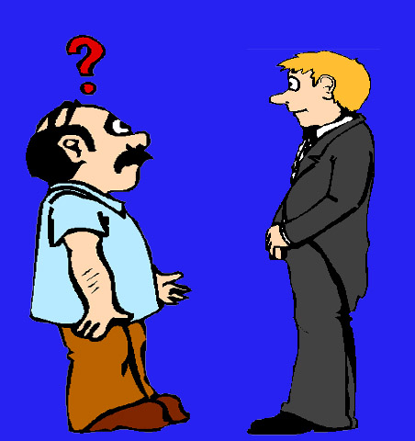
Divakar, don’t bother. Just follow the standards. I am watching. If you have any problem I am there to help you.
Hence, the following precautions have to be taken.
a) Try having workers do their job according to the standard and look carefully at what is happening.

Slide 52

Rajeev, Look at that finish! Our customers are not happy. Our boys need retraining on final finish.
b) Retrain the workers on the areas they need improvement.

Slide 53

Sunita! We could have avoided that accident. Atleast now you should introduce Poka Yoke where ever possible.
c) Institute fool proofing methods wherever possible.

Slide 54

Prem! That boy Barnetto has made this mistake for the sixth time. Take him out and put him in an area suitable to him
d) Take account of the worker's attitude for the task in hand and change him if he is not suitable.

Slide 55
We have a better solution from the workers . Change the standards accordingly
e) Revise the standards if necessary. Many of the standards do not take into account practical difficulties.

Slide 56
f) Modify the objectives and targets. Standards are not the only things that need revision. Sometimes objectives and targets can also be wrong. In that case we should collect sufficient data, reconsider and revise them, if necessary.

Slide 57
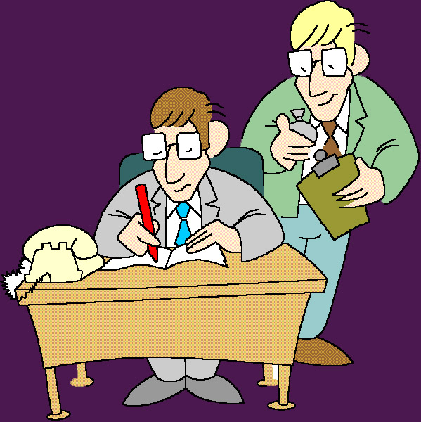
7. Check the results of the action taken.
It is necessary and it is the responsibility of the upper management for checking the effectiveness of any process. Just taking action is not sufficient but we should also check the result.

Slide 58

7. Check the results of the action taken.
Control Charts are useful for this. Control can be exercised effectively if statistical methods are used skillfully in all stages of the process. That is statistical control.
SQC METHODS

Slide 59
7. Check the results of the action taken.
When it is exercised with respect to quality it is called statistical quality control. Since our aim is to control quality we should utilise SQC methods as far as possible to achieve the result.

Slide 60
Now let us look into the Problem Solving Techniques one by one

Slide 61

Prepared by
G. Vijaykumar

Slide 62


